Slide 1
أكـــــاديميــــة طــــويـــق
Scalable Data Science

Slide 2
cuDF: GPU-accelerated Data Manipulation
Overview and Comparison with Pandas
By: Dr. Afshan Hashmi

Slide 3
Course Objectives:
This course aims to equip learners with GPU-accelerated data analysis skills using cuDF, Pandas. Students will learn how to efficiently manipulate, clean, and analyze large datasets
Course Learning Outcomes:
1. Understand GPU-accelerated computing and how cuDF differs from Pandas for big data processing. 2. Perform efficient data analysis using cuDF, including data cleaning, aggregation, and transformation.

Slide 4

Introduction to cuDF
What is cuDF?
cuDF is a GPU DataFrame library for loading, joining, aggregating, filtering, and otherwise manipulating data.
GPU-accelerated library for data manipulation.
Part of the RAPIDS ecosystem.
Why use cuDF?
Leverage GPU power for faster data processing.
Designed for large datasets.

Slide 5


Key Features of cuDF
GPU-accelerated DataFrame operations.
Similar API to Pandas for ease of use.
Seamless integration with other RAPIDS libraries (cuML, cuGraph).
Support for CSV, Parquet, and ORC file formats.

Slide 6
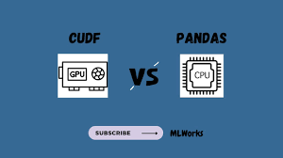

cuDF vs Pandas
Performance Comparison:
cuDF is faster for large datasets due to GPU acceleration.
Pandas is better for small datasets (CPU overhead).
API Similarity:
cuDF mimics Pandas API for easy adoption.
Memory Management:
cuDF uses GPU memory; Pandas uses CPU memory.

Slide 7
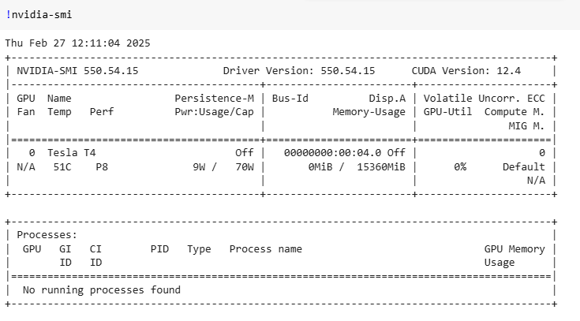
Set Up:Running with an NVIDIA GPU
NVIDIA® T4 GPU accelerates diverse cloud workloads, including high-performance computing, deep learning training and inference, machine learning, data analytics, and graphics.

Slide 8
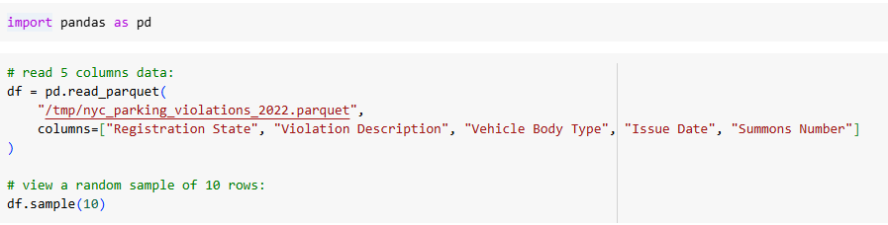
Data Analysis Using Pandas
Dataset used:
https://data.rapids.ai/datasets/nyc_parking/nyc_parking_violations_2022.parquet

Slide 9
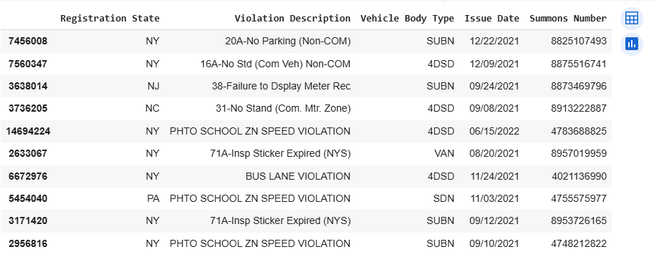
Data Analysis Using Pandas

Slide 10
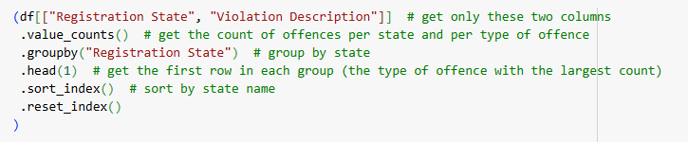
Data Analysis Using Pandas
To find the most common parking violation per U.S. state, based on vehicle registration, we used Pandas. We analyzed a dataset with state and violation data, using GroupBy and value_counts to determine the top offense for each state.
Method chaining is used to combine a series of operations into a single statement

Slide 11
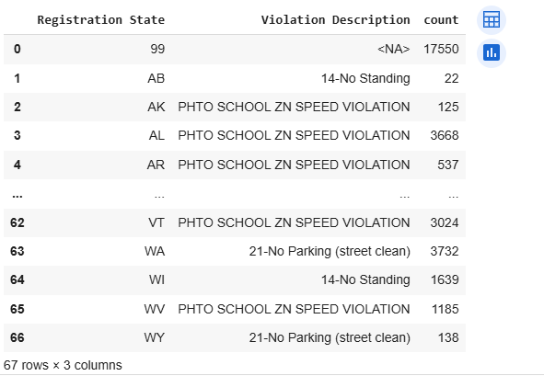
Most common parking violation per U.S. state, based on vehicle registration

Slide 12
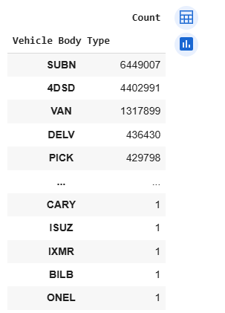
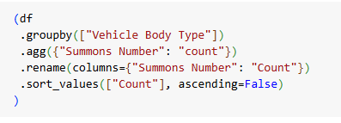
Identifying the vehicle body types that most commonly receive parking violations is a key area of analysis
Output

Slide 13
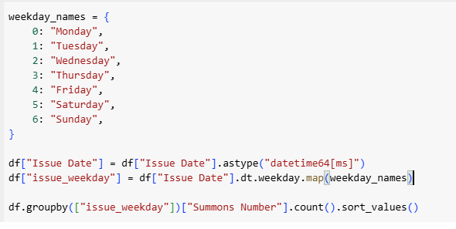
To find out the parking violation across the day of the week
A dictionary is created to map numerical weekday values (0-6) to their corresponding names.
The "Issue Date" column is converted to a datetime format (datetime64[ms]), enabling date-based operations.
.dt.weekday extracts the day of the week as an integer (0-6).
.map(weekday_names) converts this integer into the corresponding weekday name (e.g., 0 -> "Monday").
The data is grouped by "issue_weekday" (day of the week).
The number of violations ("Summons Number") is counted for each weekday.
.sort_values() sorts the results in ascending order to show which day had the fewest to the most violations.

Slide 14
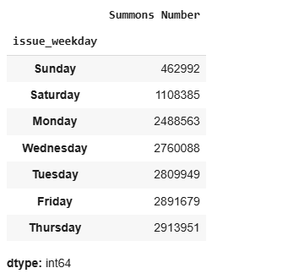
OUTPUT
A noticeable decrease in parking violations occurs during weekends, likely due to reduced weekday traffic in New York City.

Slide 15
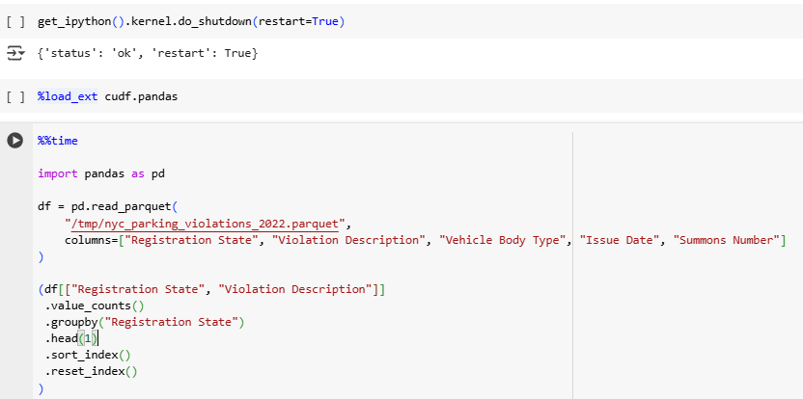
Starting with cuDF.Pandas
To demonstrate the performance benefits of cudf.pandas, we will re-execute the previously used Pandas code.
To accurately simulate a typical workflow, where cudf.pandas is loaded at the beginning, we have restarted the kernel prior to this execution.

Slide 16
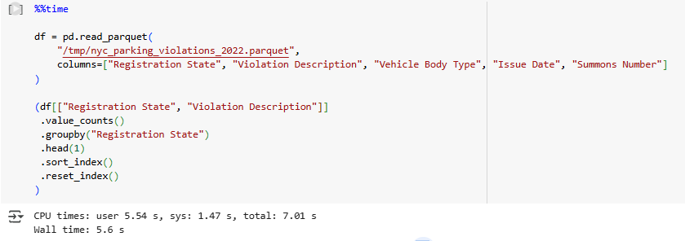
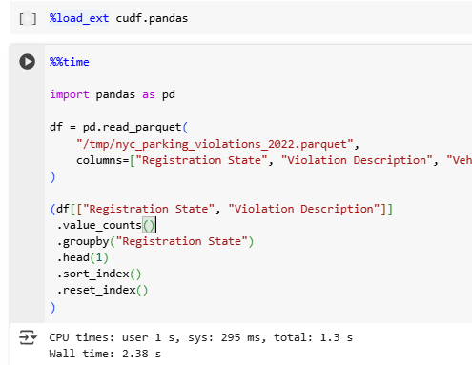
Pandas Vs cuDF.Pandas
It is clear that Pandas has taken 7.01 seconds for the same task while cuDF Pandas has taken 1.3 seconds

Slide 17
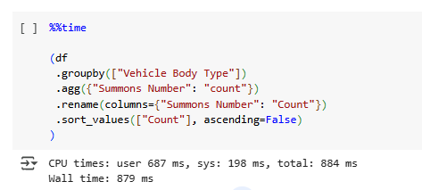
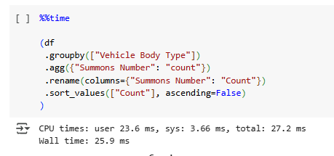
Pandas Vs cuDF.Pandas
It is clear that Pandas has taken 884 milli-seconds for the same task while cuDF Pandas has taken only 27.2milli-seconds

Slide 18
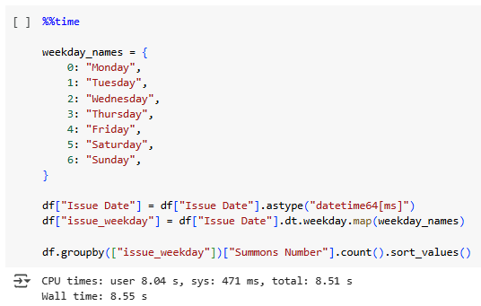
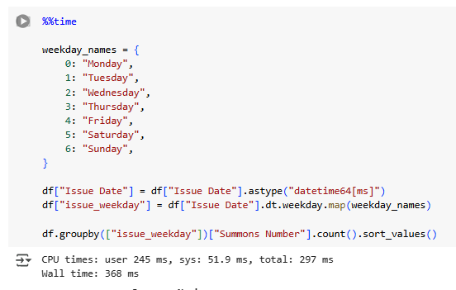
Pandas Vs cuDF.Pandas
It is clear that Pandas has taken 8.51 seconds for the same task while cuDF Pandas has taken 297 milli-seconds

Slide 19

Quiz Time Analyze Violations by Day of the Week and Vehicle Type

Slide 20
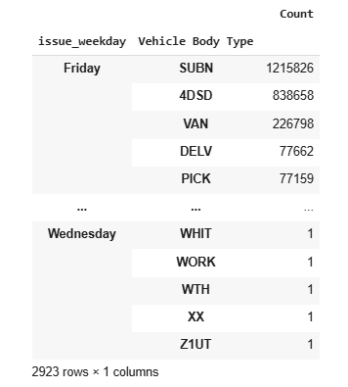
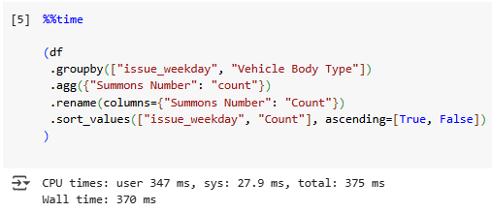
Quiz Time- Solution 1. Analyze Violations by Day of the Week and Vehicle Type

Slide 21
Quiz Time 2. Find the Top 5 Most Common Parking Violations

Slide 22
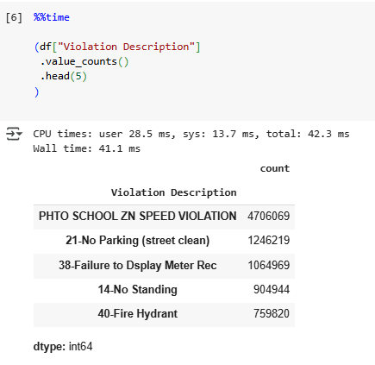
Quiz Time- Solution 2. Find the Top 5 Most Common Parking Violations

Slide 23
Quiz Time 3. Identify States with the Highest Number of Violations

Slide 24
Quiz Time 4. Find the Monthly Trend of Parking Violations

Slide 25
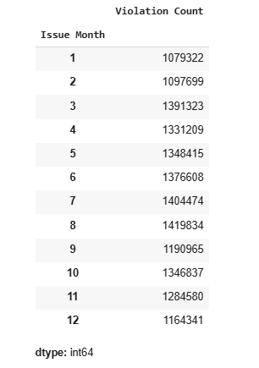
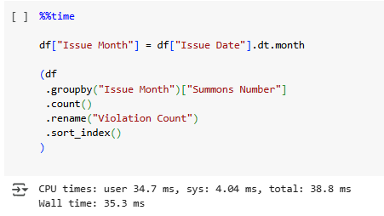
Quiz Time- Solution 4. Find the Monthly Trend of Parking Violations

Slide 26
Quiz Time 5.Find the Most Common Violation for Each Vehicle Type

Slide 27
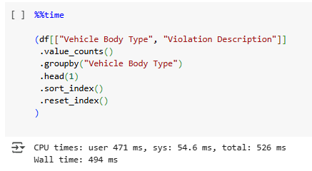
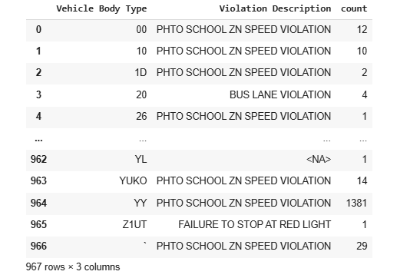
Quiz Time- Solution 5.Find the Most Common Violation for Each Vehicle Type

Slide 28
RECAP
GPU-Accelerated DataFrames – cuDF is a Pandas-like DataFrame library that runs on NVIDIA GPUs, enabling high-speed data processing.
Pandas-Compatible API – cuDF supports most Pandas functions (read_parquet(), groupby(), merge(), etc.), making it easy to transition from CPU-based Pandas workflows.
Efficient Large-Scale Data Processing – cuDF is optimized for millions to billions of rows, outperforming Pandas in data manipulation, filtering, and aggregation.
Best Use Cases for cuDF – Ideal for big data processing, ETL (Extract, Transform, Load) tasks, and data preparation before feeding into deep learning models.

Slide 29

Practical Implementation
Go To Google Colab

Slide 30

















الشراكات العالمية

Slide 31
شــــــكــــرًا لكــــــم
THANK YOU

